Slide 1


New Technologies
Bryn Bowler B7013157

Slide 2




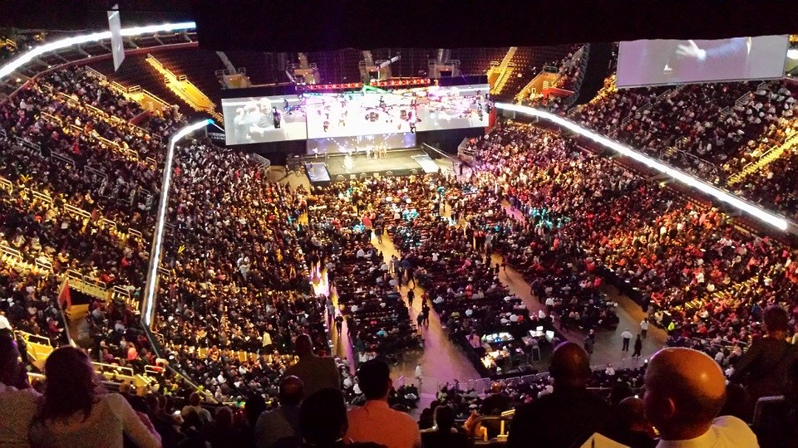

What is WIFI Chat?
WIFI Based Chat Rooms
Uses:
University Open Days
Lectures
Conventions
Music Events
Sports Events

Slide 3
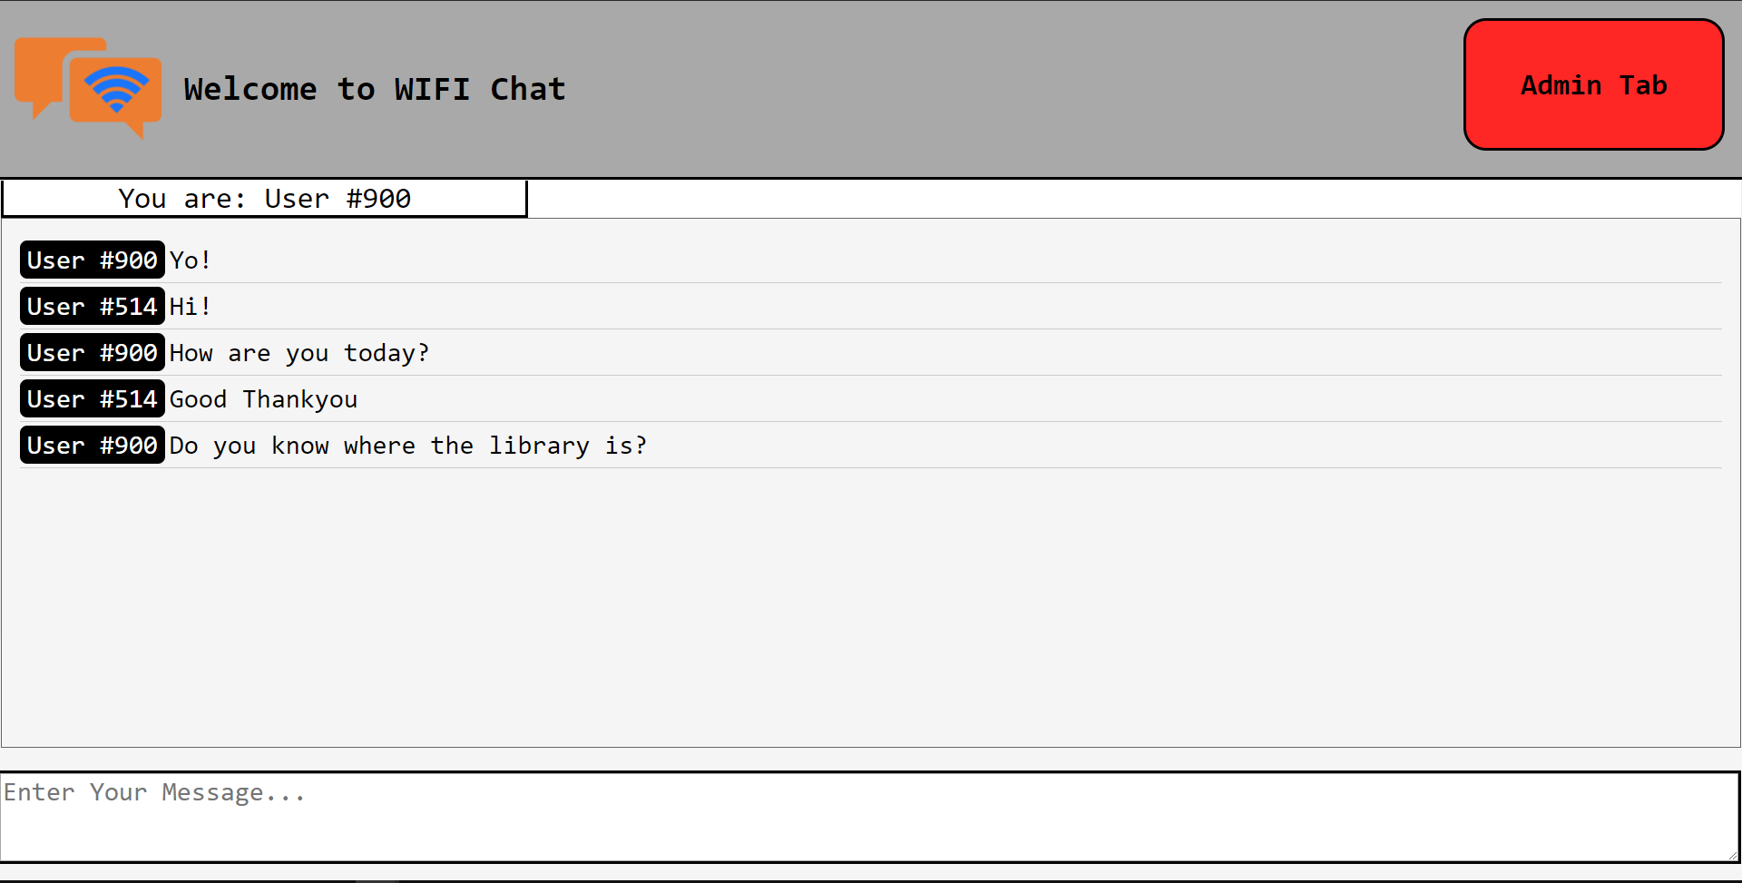
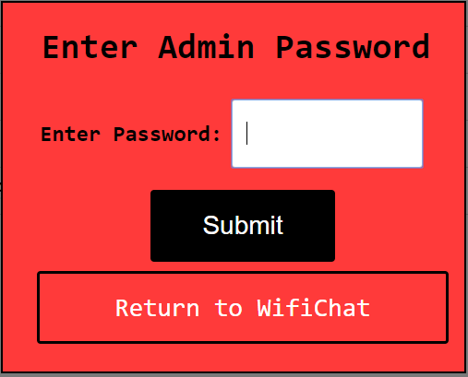
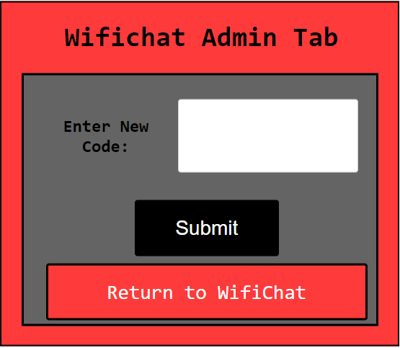
Features:
Live Chatrooms hosted on Localhost with WAMP Server
WAMP Server hosts the application on Localhost
Is accessible by anyone who is connected to that Wi-Fi connection
Users are able to communicate live to others using the application
Anonymous Users
Users are given a random user number when accessing the application allowing them to communicate anonymously
Users are given a new number every time they access the application
Admin and Security Capabilities
Admins are able to access the Admin Tab this tab allows them to change the access code to assure that only the relevant users can access the application
Admins could change the password each week then send an email with the new code to the relevant users
Accessibility on multiple Devices
Responsive web design was implemented to assure that the application could work on multiple devices

Slide 4




Tools and Languages Used:
HTML
HTML was used to create the web application skeleton
CSS
Used to style the webpage
Javascript
Javascript gives responsive functionality to Admin Tabs
Text File
Used to store messages
jQuery AJAX
Used to construct messages to send to the Text File
Checks the text file to see whether new messages have been submitted
Used to post messages to the chat box on the application
PHP
PHP transfers messages to and from the Text File

Slide 5


Tools and Languages Used Extended:
WAMP Server
WAMP Server hosts the application on Localhost
MySQL
Saves the access password that can be changed by the admins

Slide 6


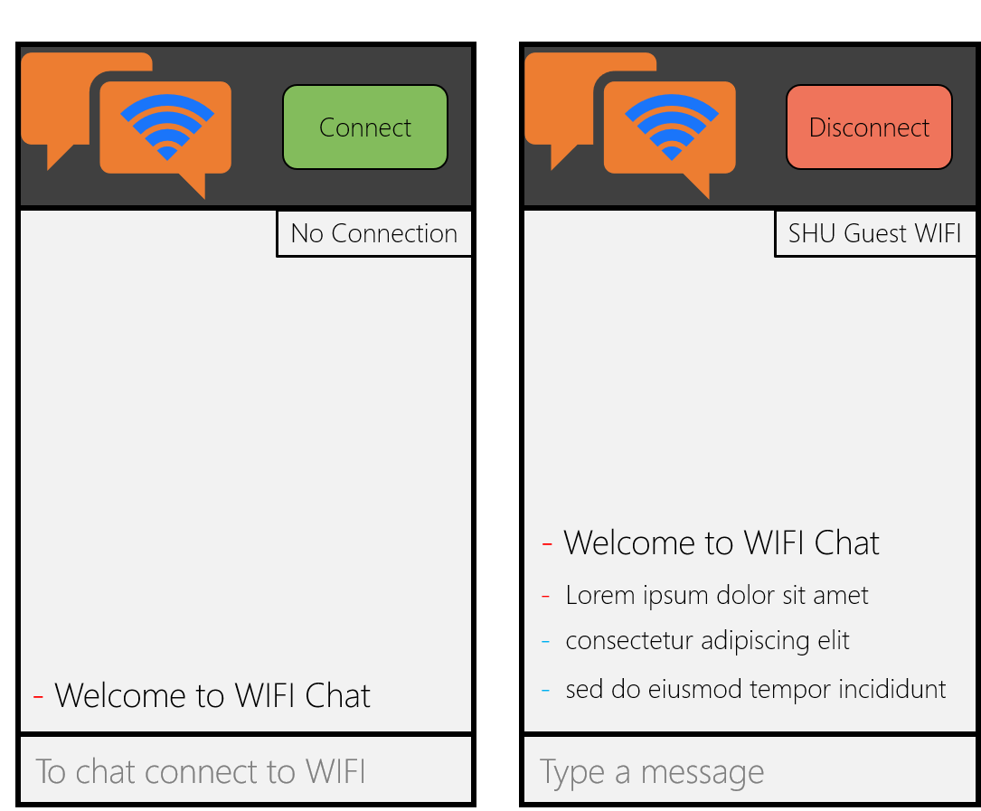
How it works:
Text File
PHP
PHP
AJAX
Live Messaging
Users enter their message and press send
jQuery constructs a message that contains the username and the message they will be sending
PHP sends the message to the text file
jQuery alerts the application that a new line has been entered in the text file
PHP pulls the message back
jQuery submits the message into the chat box
AJAX
HTML + Javascript

Slide 7
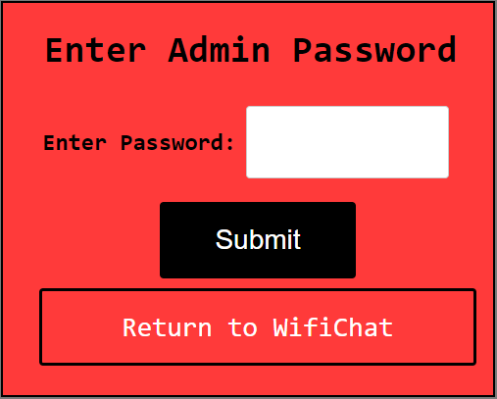
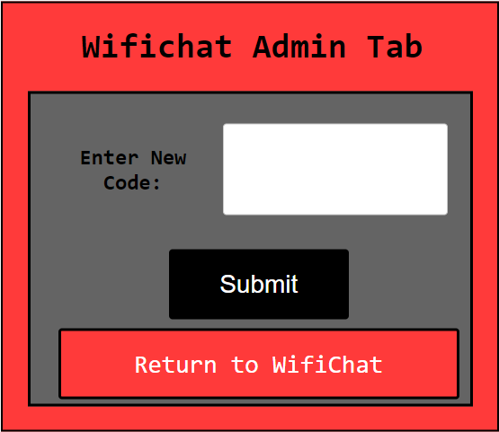
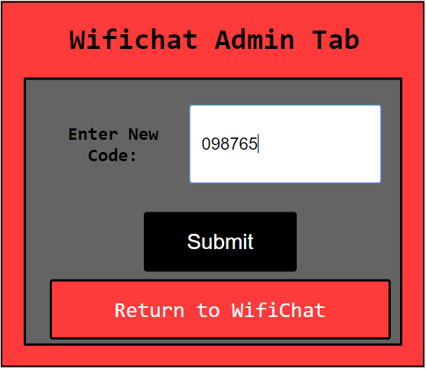

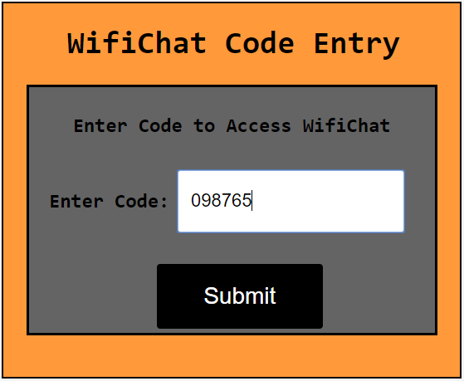
How it works:
Admin Privileges
Admins enter the password to access the Admin Tab
Admins can change the password here
The password is updated on the backend database
Users must now enter the new password when they access the site

Slide 8




Biggest Challenges Encountered:
Setting up WAMP Server to be compatible on different internet connections
Creating responsive web pages that can host the application on many devices
Research into a viable method of posting and receiving messages
Coding and troubleshooting the chosen method
Testing the application in different locations and on different networks

Slide 9




Biggest Successes of the Project
Successful Live Messaging
Admin privileges
Anonymous users
Missed Opportunities & Unsuccessful Objectives
Size Limited Chat-Rooms
Profanity Filters
Easy WIFIChat.exe Setup
Budget
No Budget was required for this Project

Slide 10
Could this Project be considered a Success?
The Application fulfils it’s main objective to be a WIFI Based Chatroom Web Application
The Application extends on this adding features to improve the usability for the users
The Application incorporates security features and Admin Privileges
The Application fails to incorporate certain features planned during development
Profanity Filter
Time Limited Chatting
Chat Room Size Limit
Easy Application Setup
Overall I believe this project was a success. The application does what it set out to achieve and is a usable application.
It could do with further improvements that had been suggested but could not be developed due to either time or programming difficulties to increase the usability of application for both users and hosts.

